Slide 1
Why WordPress?
The case for entrepreneurial
web development
Shaylee Hansen

Slide 2
WHOAMI
Blogger, WordPress Developer & Consultant,
Wannabe Entrepreneur & Pokemon Trainer

Slide 3
“Web developers have an entrepreneurial spirit. Like entrepreneurs, they share the passion and ability to make things.”
-Anonymous

Slide 4
INTRODUCTION
Notes:
INTRO:
I’ve been working professionally as a web developer for a little for a year and in that time I’ve come to learn a few things about WordPress. One of which is that WordPress is not the ugly redheaded step child that many web developers claim it to be.
******
It was late 2015 and I had just finished a 12 week course in Python Web Development and looking for my first job as a web developer. I had just quickly came to the realization that getting a job as a Django Web Developer was going to be very unlikely.
What's a girl to do? As luck would have I found an opening as an entry level web developer for an agency that... you guessed it....developed websites using WordPress. I was less than thrilled. However any experience is better than no experience right?
****
It was my first time working with WordPress professionally and honestly I wasn’t a fan. I preferred working with Django. I kept of trying to think of a convincing argument in favor of using Django over WordPress. I even spent time building Django Content Management Systems to prove how much better Django was over WordPress. However, there was a problem that kept arising for me that Django couldn’t solve.... It was this, WordPress had a CMS that was well known, very popular and easy to use. Django unfortunately, did not.
*******
Since then I've worked for another agency that developed sites using both WordPress and Django. That is when I was finally came to understand why WordPress not Django is the winner in the CMS battle for greatness. And it came down to this, WordPress... is amazingly simple and intuitive for its users…. users that could one day be your future clients.
*****
Today I would like to share with you why you should reconsider WordPress and what it can do for you... the entrepreneurial web developer.
I will begin with a few facts about WordPress... next I will explain why I think WordPress is the ideal option for your clients, then....I will introduce
you to new technologies like the WordPress REST API, after that I will invite you to try WordPress even if you don't consider yourself a "coder",
share ideas with you on the type entrepreneurial careers out there for WordPress. Encourage you to checkout the WordPress community and
share my favorite resources and conclude with an inspiring thought and summary.

Slide 5
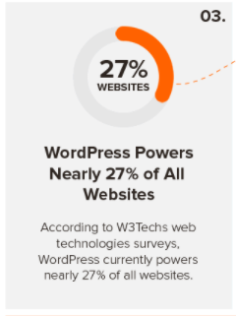
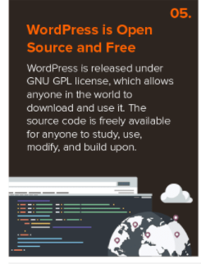
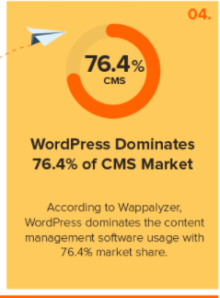
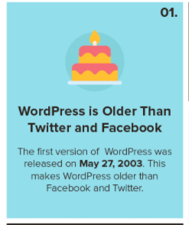
Facts
Notes:
FACTS:
WordPress launched in May 27, 2003. That makes WordPress Older than Twitter and Facebook.
WordPress currently powers nearly 27% of all websites worldwide.
WordPress Dominates 76.4% of CMS Market.
Despite what you have heard, the WordPress community is extremely diligent in its efforts to keep WordPress secure. As long as you use its best practices you are going to be as safe as you would in any other environment.
WordPress is an Open Source project which means hundreds of people all over the world are working on it. This also means that you can use it without paying anyone a license. In layman's terms, it is free!!!!
20% of WordPress is written in JavaScript and is expected to grow as WordPress becomes more like an application development framework.
( Javascript isn’t going anywhere guys..learn it!)
From these statistics it is safe to say that WordPress is here to stay.

Slide 6
WordPress: Ideal choice for your clients & here is why...
Notes:
Control, Cost, Client Onboarding, Customization and the bottom line
Control
As the WordPress Developer you get to decide what your client has access to and what they do not through backend customization. If something can go wrong. It probably will and if you can mitigate it, you should. The fewer the choices your client has to make the better.
Here are two scenarios in which backend customization should be required:
Scenario 1) Your client knows just enough HTML and CSS to get themselves in trouble. They decide to open up the theme editor and take a peek at the files...next thing you know you are getting a support email because the social media icons are missing and the links to the website are all different colors.
You can prevent this type of “experimentation” from happening by editing your wp-config.php with <next-slide> :

Slide 7
define('DISALLOW_FILE_EDIT',true);
Notes:
Now it is impossible for them to access the theme or plugin editor even with an admin account
Scenario 2) Your client has found out they can install and activate any theme they want to. So they go to down installing and activating a variety of different themes, just to see what they look like. All of a sudden they notice that their content is missing. They try to switch back to the theme you built for them but it is missing. What happened…. they accidentally deleted it.
Your client should never ever have access to theme and plugin installation. They hired your to create a theme for them for a reason.
This catastrophe could have been prevented… again by editing the wp-config.php file with ->

Slide 8
define('DISALLOW_FILE_MODS',true);
Notes:
This makes it so users won’t be able to install or update plugins or themes.

Slide 9
Cost of a no frills website:
$46 to $100 YEAR ( hosting & Plugins cost included) +
( $30/hr * 40hrs ( finishing in a week ) ) =
$1200 - $1500 per website
Notes:
Cost
WordPress is free to use, quick to install and offers thousands of free plugins for website development. This allows you as the web developer to create websites at a reasonable cost for your clients.
According to WPBeginner the total cost of a fully functioning WordPress website with minimal features is between $46-$100 dollars a year ( hosting and plugin costs included ). Assuming you can build a website start to finish in a week at a $30 hour rate you can easily earn $1200 - $1500 per website. Agencies charge five time that for a basic no frills website.

Slide 10
Client Onboarding
Notes:
Client Onboarding
After a WordPress website is finished and ready a client will need to go through CMS ( content management system ) onboarding. This is where the client will go through the ins and outs of the website and is shown how to add content and make image updates. I've built a few Django CMS's and I couldn't fathom trying to teach the CMS to a non-techie. For me as the web developer the Django CMS makes sense because I built it and I know how the functionality should work. But for a non-techie, understanding the difference between a post and page is confusing enough. Compared to other CMS's that are around WordPress is still the most user friendly and intuitive of them out there. *So use what they are already familiar with *

Slide 11
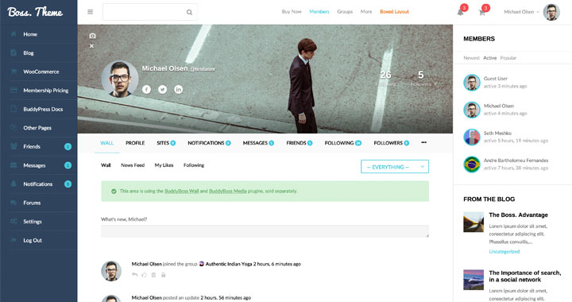
Customization
Notes:
Customization
WordPress provides you with the tools to make any type of website your clients might need, from online stores to blogs, to membership sites and beyond. WordPress is really your one stop shop.
The biggest complaint I hear about WordPress is that all WordPress websites all look the same and aren’t very custom. I hear your complaint and disagree. WordPress websites can be customized as little or as much you want. A theme can be created from scratch or re-engineered. The sky’s the limit.

Slide 12
Bottom Line
Notes:
Bottom line
The client you are building the website for isn't going to care what kind of technology you used to build their website with. All they are going to care about is that they have a professional looking website that works, is easy to maintain, increases their profits and customer base. You are developing websites for small businesses. You aren't making applications for future Twitter's or Ubers so stick to WordPress.

Slide 13
WordPress Rest API
Notes:
Now that you know 20% of WordPress is built with Javascript you will be delighted to learn that there is a WordPress JSON Rest API.
What is the WordPress Rest API you ask? Well in short it allows you the developer to use other programming languages to build WordPress websites. How
cool is that??? You can continue to using Javascript, Python and Ruby just to name a few to build your WordPress site. What this means in the long term is
that you won’t have to worry about learning PHP.
Download the https://wordpress.org/plugins/rest-api/

Slide 14
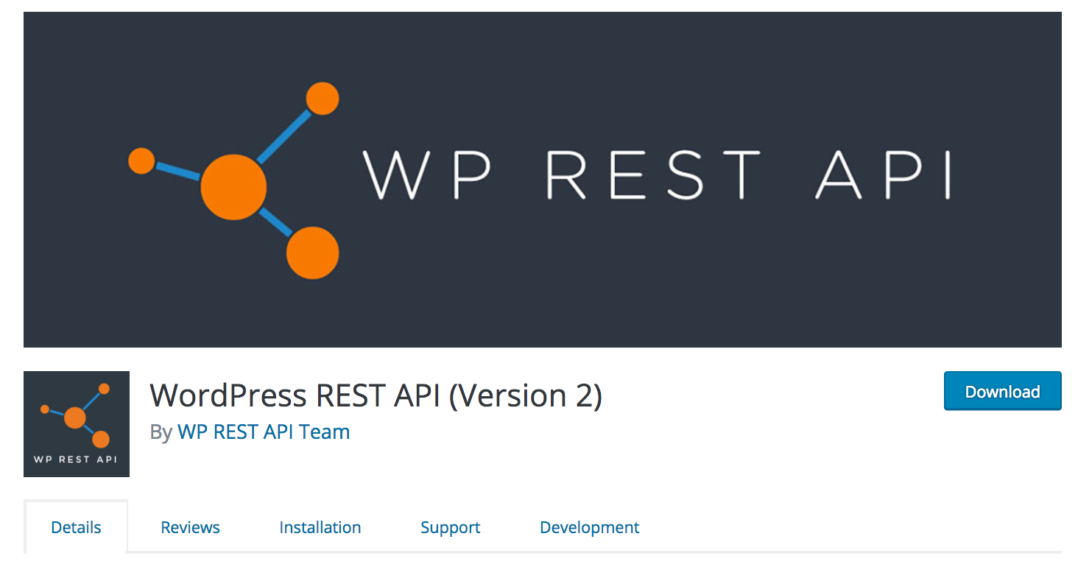
https://wordpress.org/plugins/rest-api/
Notes:
If go to WordPress.org/plugins and search for WP Rest API you will be able to download and check it out. Since this in beta I recommend experimenting on a local environment. Once you have this downloaded you will be able to make http requests to check out posts, pages and categories just to name a few. So check it out.

Slide 15
Don’t want to learn code? Don’t worry WordPress provides a way around that.
Notes:
For those of you who aren't really coder's and the thought of javascript gives you a minor panic attack don't worry. This next bit of information is for you. However before I continue I must provide you with a disclaimer: If you plan on staying competitive in the world of web development it is IMPERATIVE that you learn to code. Ok so now that you've been warned let’s continue.
I’m a WordPress consultant in my current position at Mojo Marketplace. What does this mean to you? It means I spend the greater part of my week teaching, coaching and helping build websites for individuals that have very little if any web development skills. These are mostly entrepreneurs, bloggers and some hobbyist who heard that WordPress was easy and that they would be able to get a website up and running in no time sweat. If you have tried building your own website before you know this is no easy task and it’s easier said than done. To add to that you probably know what HTML is and CSS. The majority of the people I work with don't. And you know what??? I've seen them make some pretty cool websites. Amazed? I am almost everyday.
So how do they do it you ask? Well let me tell you. They follow a simple three step process.
They pick a great theme
Plugins are there best friends
They invest money in WordPress tools.

Slide 16
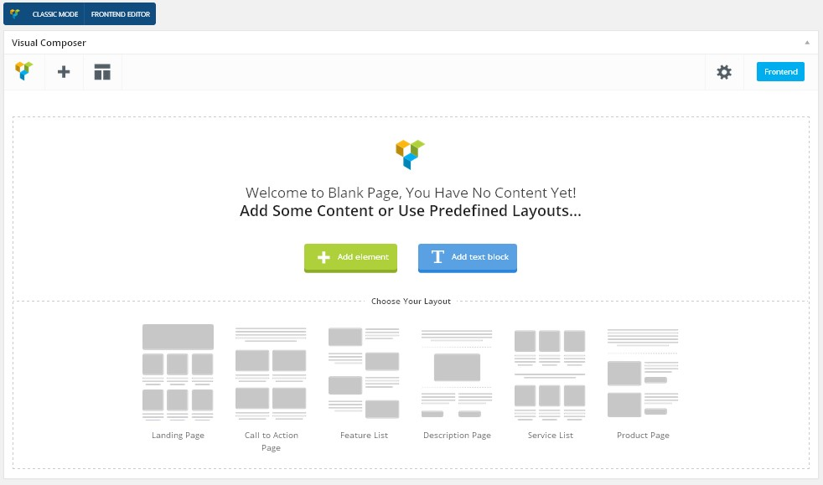
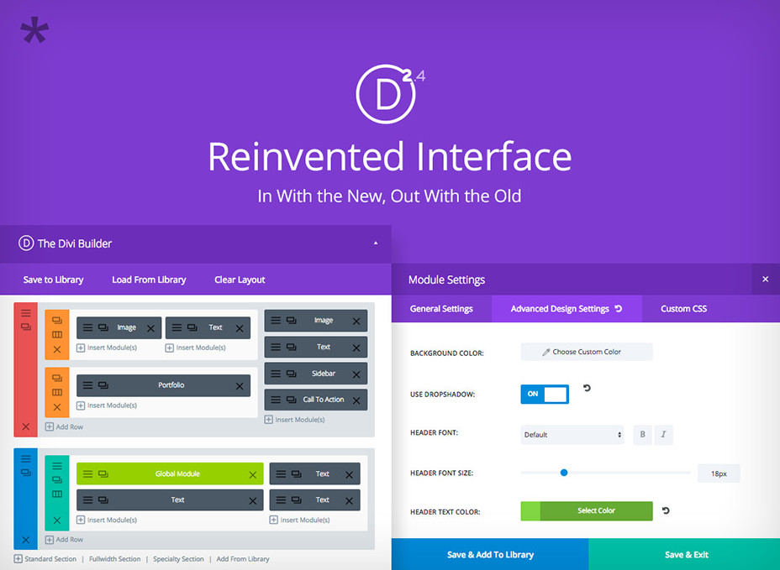
Great Theme !
Notes:
Great Theme
So let's start with what I mean by a great theme. It is imperative that the type of theme they use has some type of a visual builder. What exactly is a visual builder you ask? Well it’s a tool that allows the user to add rows, columns, and elements to a page through drag and drop process. If you have ever played around with WordPress think of them like more advanced widgets. This allows them to be able to layout the page how they want without having to know HTML, CSS and JavaScript.
Check out Visual Composer, Beaver Builder or Divi

Slide 17
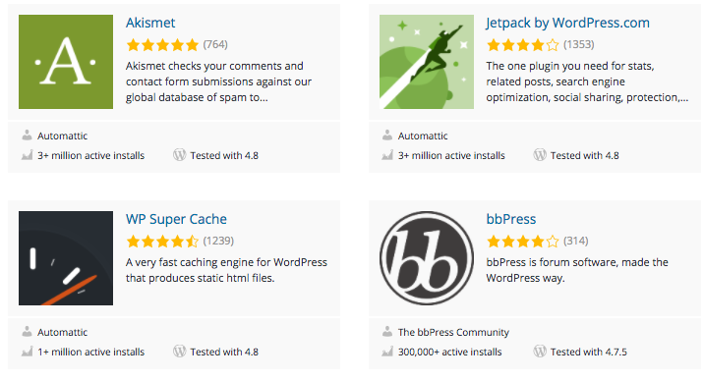
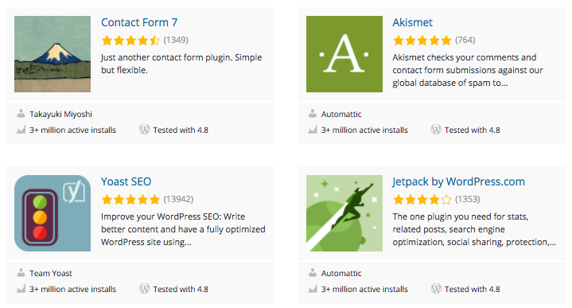
Plugins
Notes:
Plugins are your best friends
Plugins. I've helped customers install and use plugins that would allow them to build their own store, update their Facebook feed when they create a new post, create their own slides, format their posts like they would a Word Document, and create their own sign up forms that popup on the homepage all without code, thanks to plugins.

Slide 18
Investing
Notes:
Investing. Free plugins and inexpensive themes will only get you so far without some bit of web development experience. That is why it is important to understand that yes you can create an entirely functioning WordPress website without needing to be a web developer, you won't be able to do it completely for free. Will you save thousands of dollars doing it yourself? Oh you definitely will.

Slide 19
Careers….Entrepreneurial in nature
Notes:
If you are into the whole entrepreneur, self employed thing like I am there are no shortage of opportunities out there. The hardest part is going to be to picking one and sticking with it.

Slide 20
Contractor
Notes:
Contractor ( Develop, Design, & Debug )
Contracting is very popular in the world of tech. If you love building websites, have a knack for designing and enjoy debugging WordPress contracting may be your way to go. Sites like Freelancer and UpWork, WPHire and Fiverr can get you your start. Initially you aren't going to be making tons of money on these sites but you may be able to pay for your cellphone bill or groceries with the earnings.

Slide 21
Consultant || Coach
Notes:
Consultant / Coach
Do you find you have a knack for explaining tech to the un-techie? If you do you should consider become a WordPress Consultant. Teaching/Coaching WordPress has been around for a while but has started to pick up more steam recently.

Slide 22
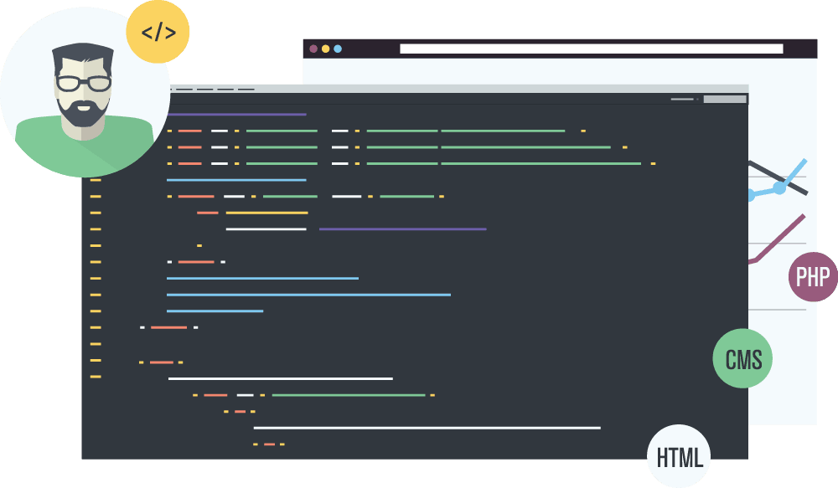
Theme & Plugin Developer
Notes:
Theme & Plugin Developer
If you enjoy building and designing themes, being a theme developer might be your jam. If you rather develop tools to make a WordPress Developer’s life easier then consider plugin development Once you have a theme or plugin built you can then sell it to on online marketplaces like Mojo Marketplace and Theme Forest for profit!!!

Slide 23
Blogging and Marketing
Notes:
Blogging & Marketing
WordPress magazines are looking for regular contributors and will pay for a well written articles or tutorials.
Not into writing about tech? Make money blogging about your passions through affiliate marketing instead.
What you aren’t into writing. Don’t worry you can market WordPress products through social media channels via affiliate marketing.

Slide 24
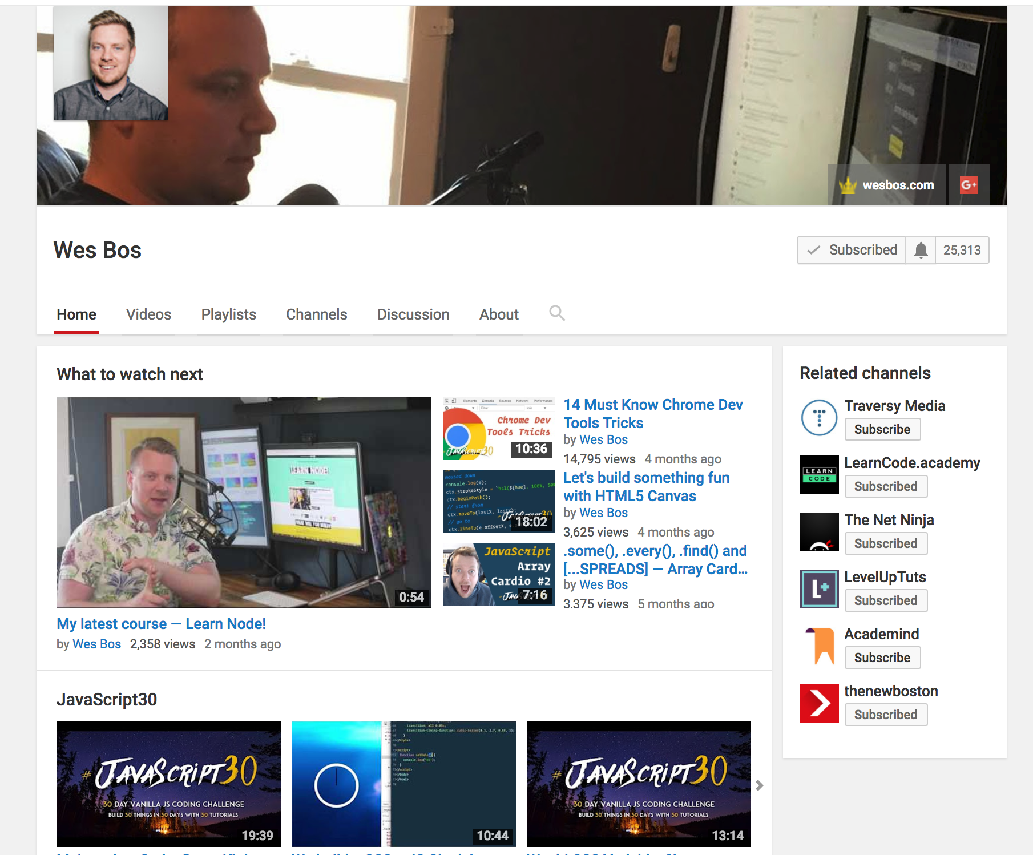
Podcaster & Youtuber
Notes:
Podcaster & Youtuber
If you enjoy public speaking or have always dreamed of becoming a radio dj consider podcasting. Not only will it increase your brand awareness but you can receive compensation through various channels like podcast sponsorships and affiliate marketing. Wanna share your skills in 3D consider Youtube. You know...lots of developers are using Youtube to learn how to code these days.

Slide 25
Community & Resources
Notes:
WordPress is well known for its inclusive community. Every year their are hundreds of events called WordCamp's where bloggers, entrepreneurs, hobbyists and professional developers get together to learn about and discuss the upcoming trends in WordPress. These are akin to developer conferences. In Utah we have an annual WordCamp and several meetup groups that get together on a regular basis.
If you are interested in getting into WordPress there is no shortage of resources. From Podcasts to Youtube videos, from blogs and tutorials to courses and WordPress forums. WordPress has literally has it all.
Here are a few of my favorite resources that help keep me in the loop:
Podcasts: WP Watercooler, Your Website Engineer

Slide 26
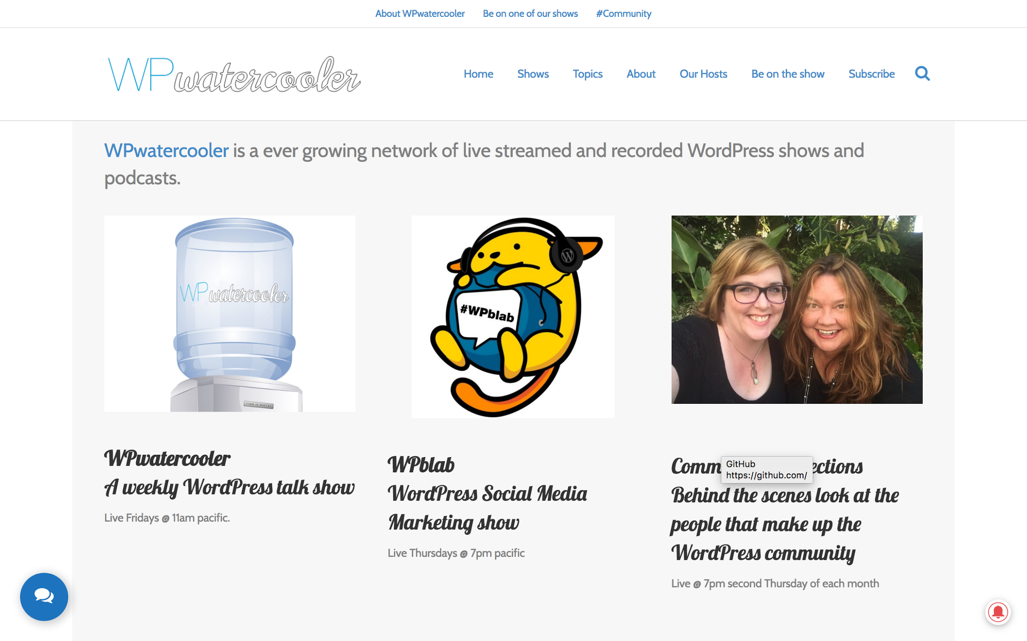
https://www.wpwatercooler.com/

Slide 27
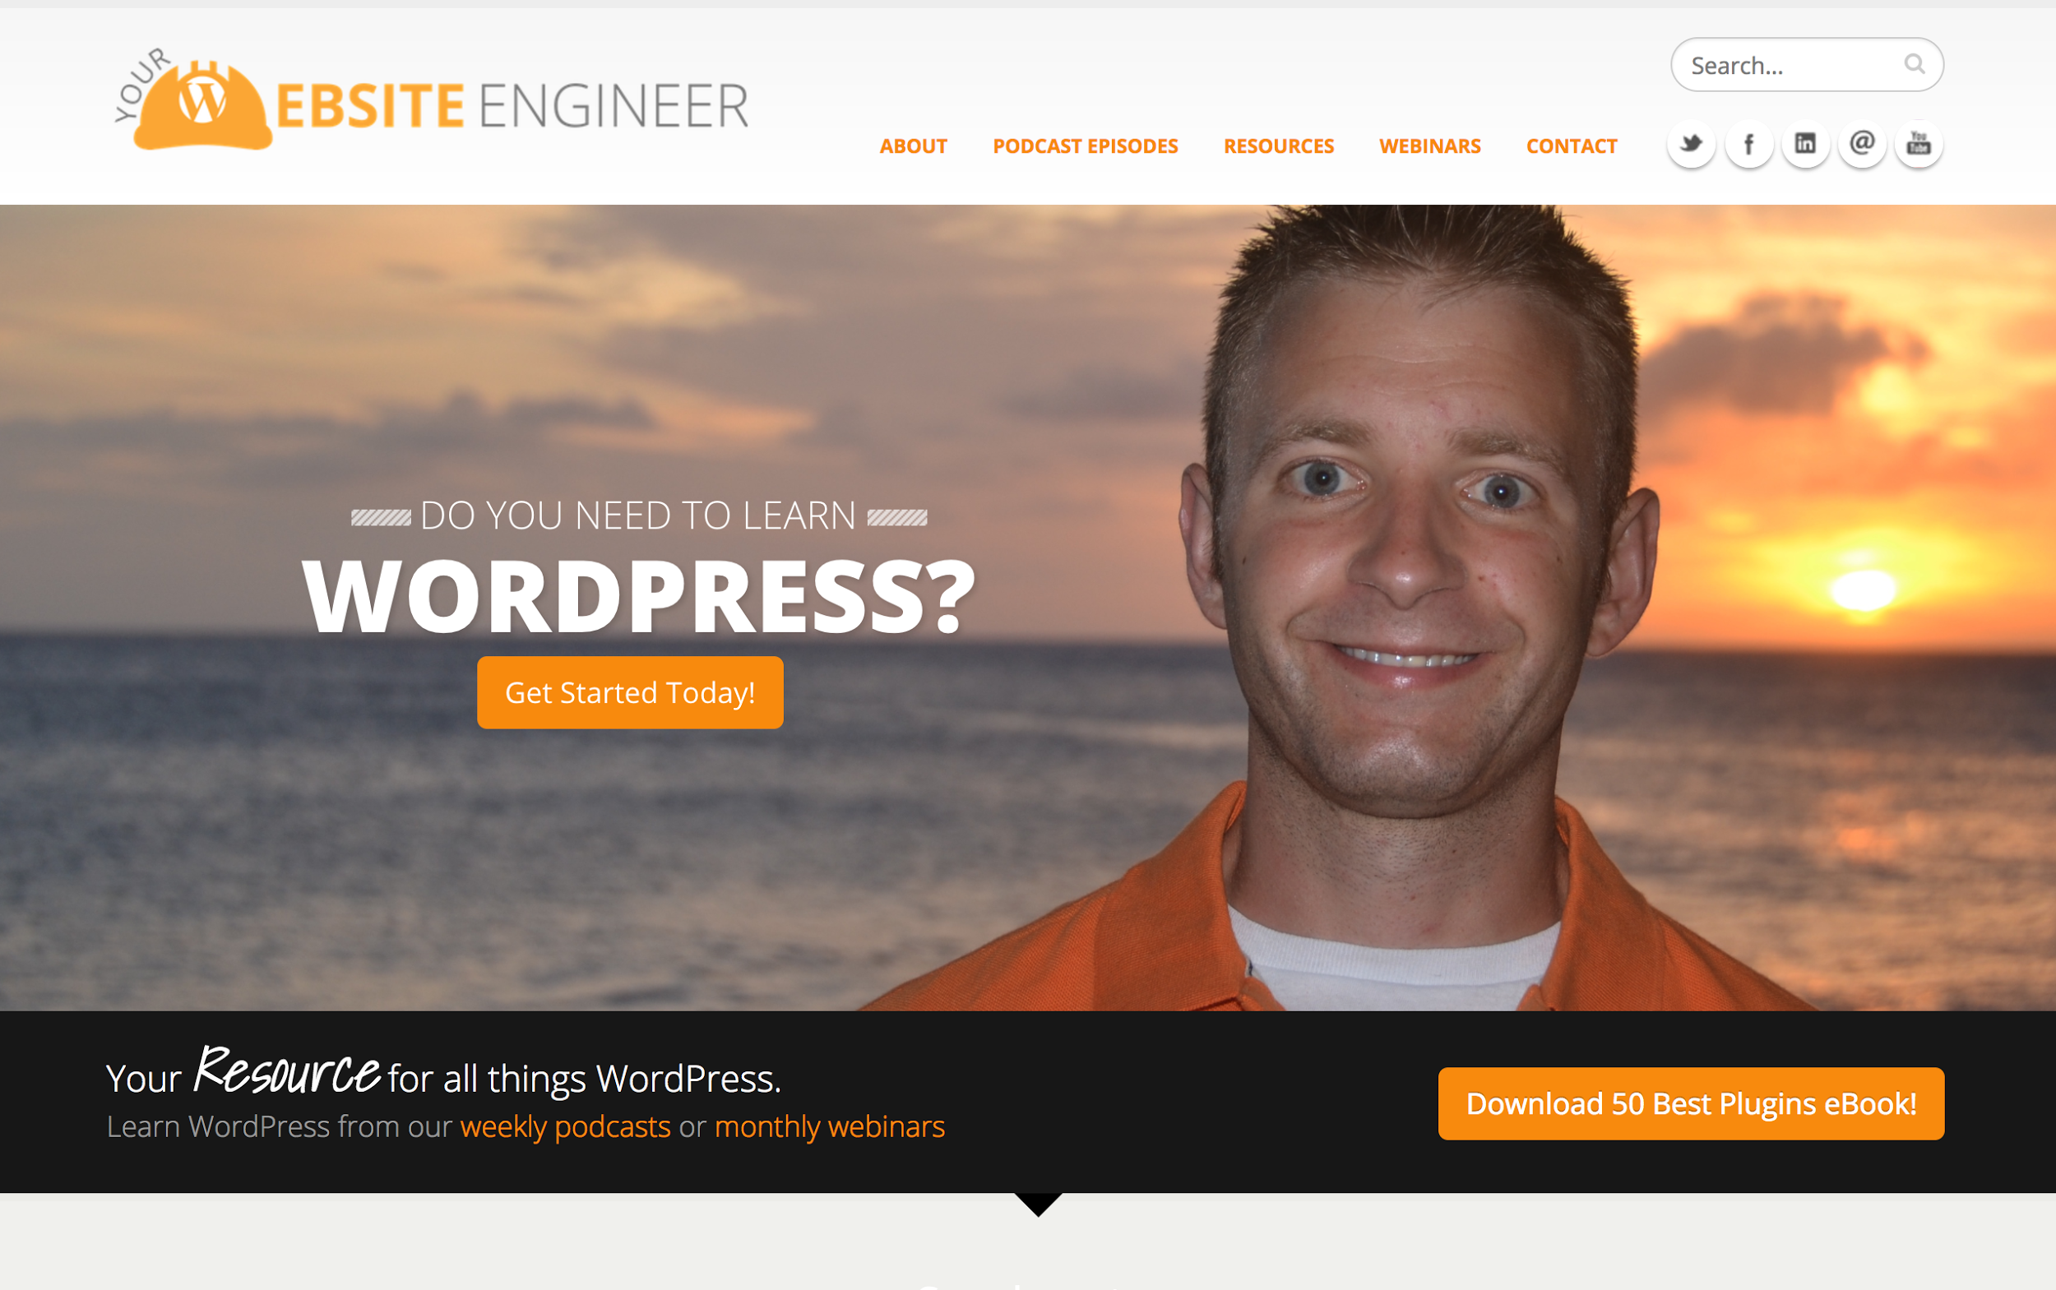
https://yourwebsiteengineer.com/

Slide 28
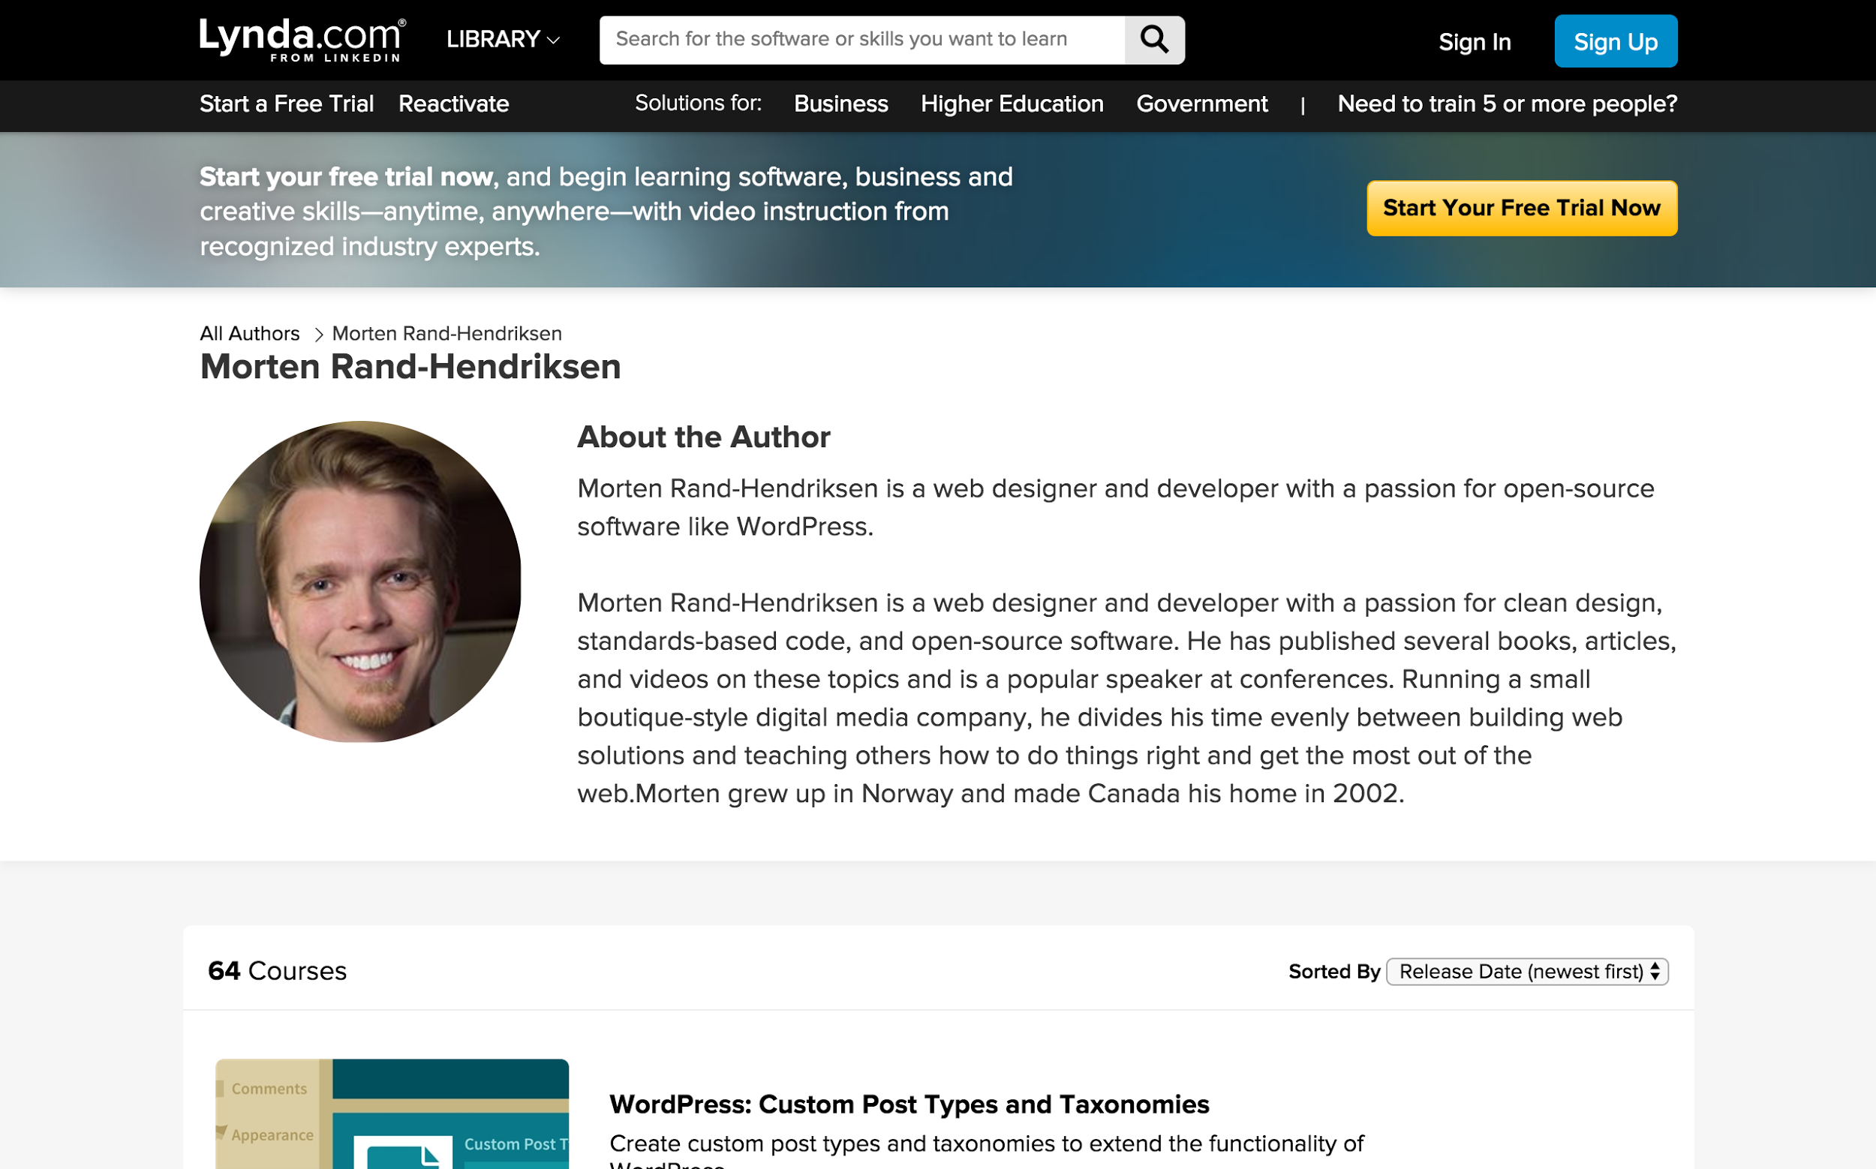
https://www.lynda.com/Morten-Rand-Hendriksen/725535-1.html
Notes:
Courses: Anything by Morten Rand-Hendriksen on Lynda.com ( quick side note, if you have a library card you can get all Lynda.com courses for free )

Slide 29
https://wpshout.com/
Notes:
Blogs: WPShout & WPBeginner

Slide 30
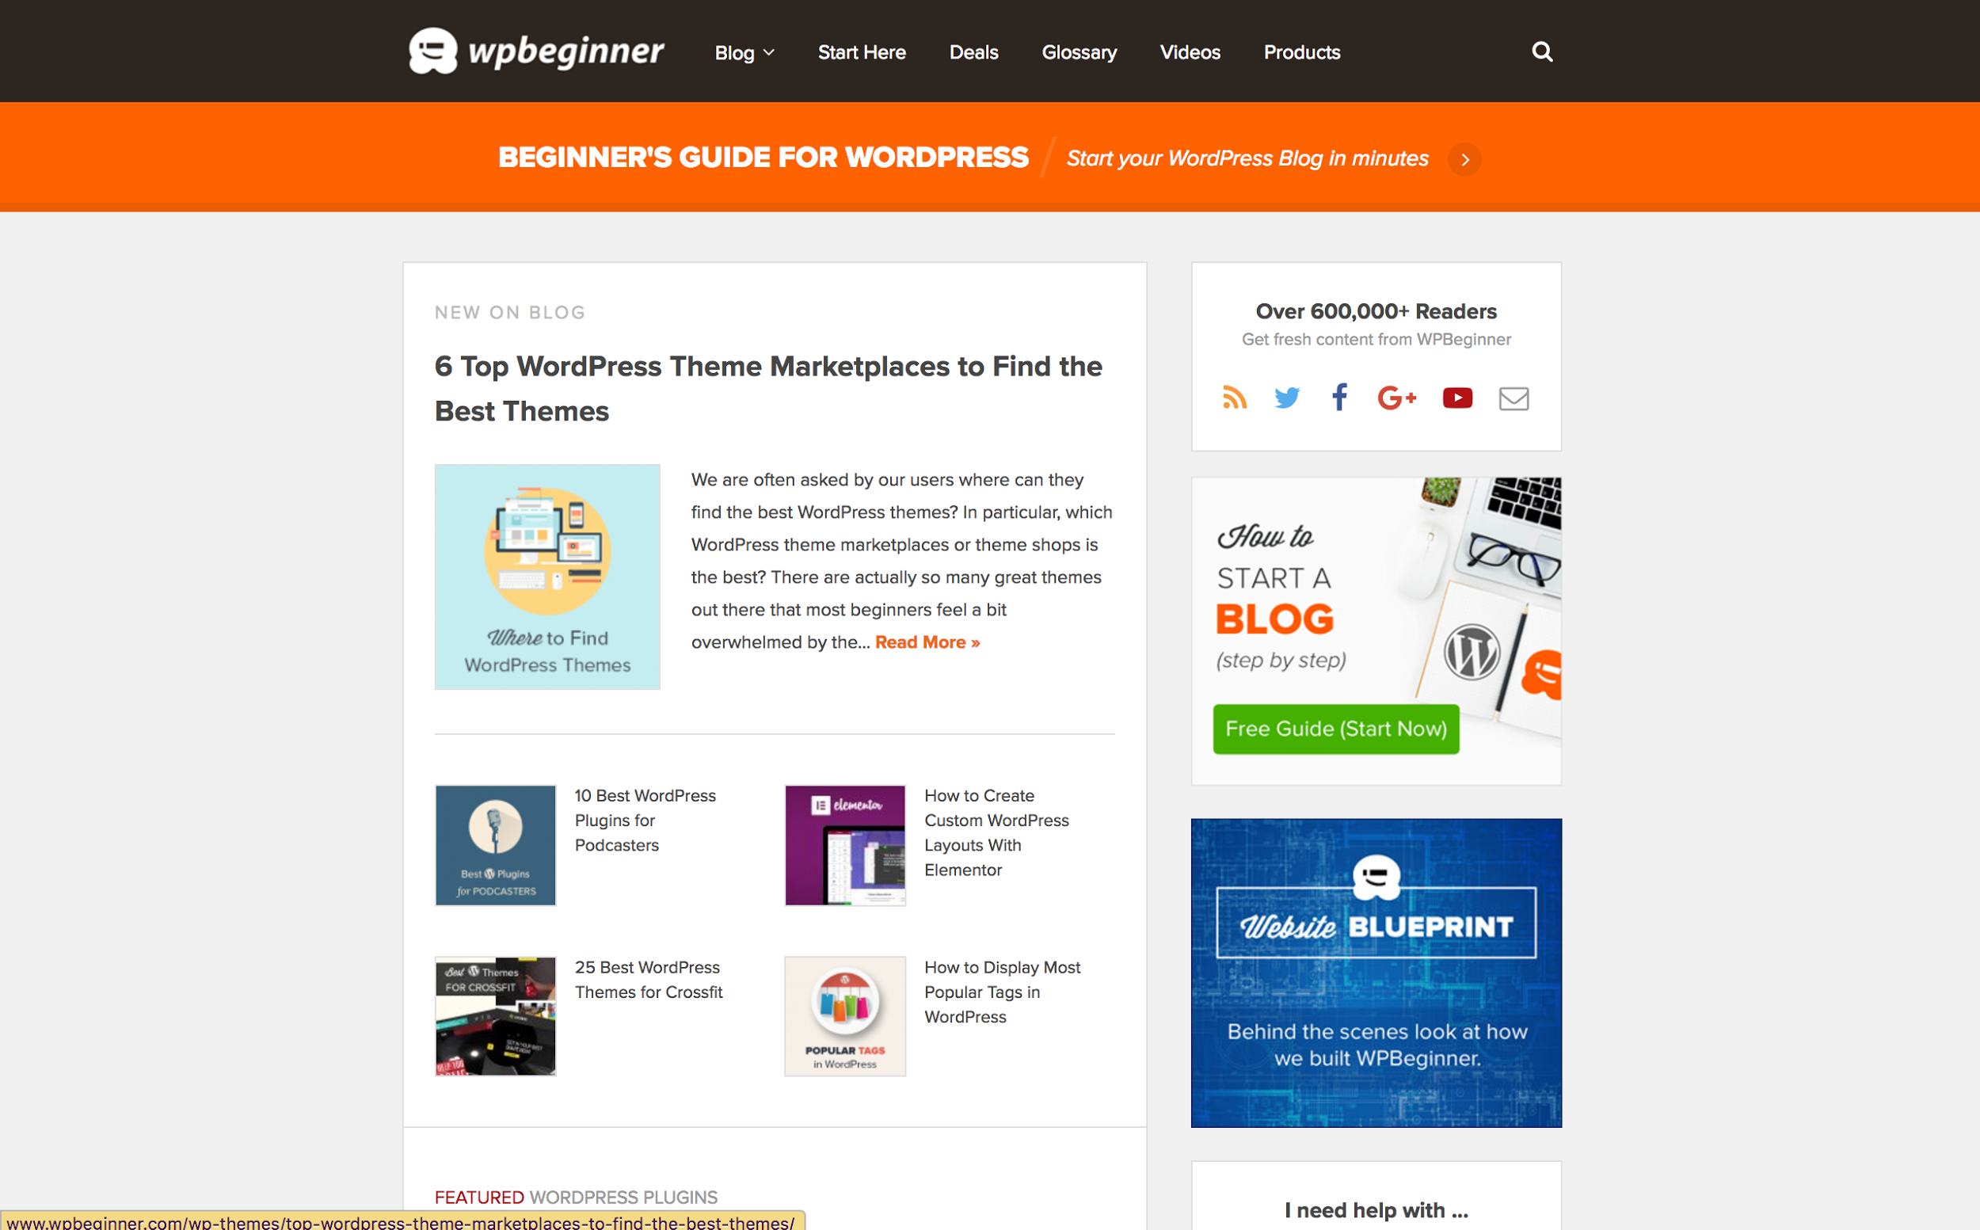
http://www.wpbeginner.com/
Notes:
WP Beginner

Slide 31
WordPress: A place for you whatever your talents
Notes:
As I started my journey into the world of web development I struggled. Like so many code newbies I’ve found it difficult to find my place in tech.
From trying out different web development languages to attending meetups and conferences, to working as a web developer.
*****
For me WordPress embodies everything that I initially wanted when I decided to change my career and go into web development. I wanted to know how to
make websites that did cool things that would allow me to make money and provide me with flexibility to do what I want when I want.
The ultimate millennium dream right?
With WordPress I really believe that is possible. Afterall that is why I’m here speaking with you today.
Everyday I work with people who are actualizing their dream and guess what? They are using WordPress to do it.
WordPress has a place for you…. whatever your talents.

Slide 32
WORDPRESS
Dominates the Market!
Ideal choice for clients!
WordPress Rest API. Say hello Javascript and goodbye PHP ( hehe )
You Don’t have to learn to code to build a site with WordPress :)
Community & lots and lots of resources :)
Careers...make your own with WordPress!
WordPress has a place for you whatever your talents

Slide 33
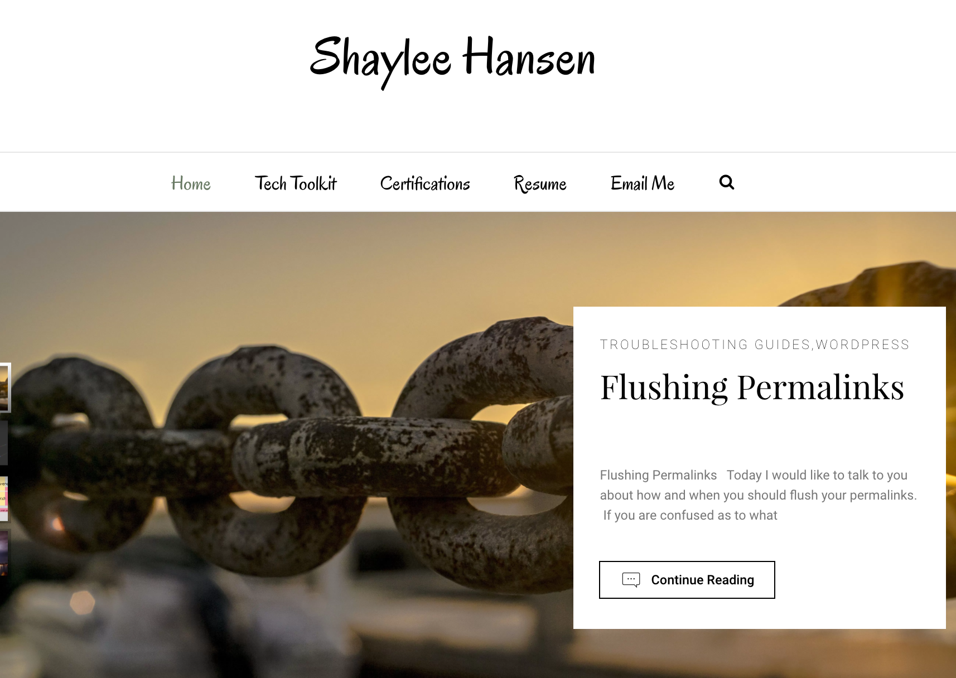
Shaylee Hansen
@HansenShaylee
shaylee1@me.com
http://shayleehansen.com

